Slide 1
Multimedia Data Mining

Slide 2
Multimedia Data Mining
Multimedia data types
  any type of information medium that can be represented, processed, stored and transmitted over network in digital form
  Multi-lingual text, numeric, images, video, audio, graphical, temporal, relational, and categorical data.

Slide 3
Definitions
Subfield of data mining that deals with an extraction of implicit knowledge, multimedia data relationships, or other patterns not explicitly stored in multimedia databases
  Influence on related interdisciplinary fields
  Databases – extension of the KDD (rule patterns)
  Information systems – multimedia information analysis and retrieval – content-based image and video search and efficient storage organization

Slide 4
Information model
Data segmentation
  Multimedia data are divided into logically interconnected segments (objects)
  Pattern extraction
  Mining and analysis procedures should reveal some relations between objects on the different level
  Knowledge representation
  Incorporated linked patterns

Slide 5
Generalizing Spatial and Multimedia Data
Spatial data:
  Generalize detailed geographic points into clustered regions, such as business, residential, industrial, or agricultural areas, according to land usage
  Require the merge of a set of geographic areas by spatial operations
Image data:
  Extracted by aggregation and/or approximation
  Size, color, shape, texture, orientation, and relative positions and structures of the contained objects or regions in the image
Music data:
  Summarize its melody: based on the approximate patterns that repeatedly occur in the segment
  Summarized its style: based on its tone, tempo, or the major musical instruments played

Slide 6
Similarity Search in Multimedia Data
Description-based retrieval systems
  Build indices and perform object retrieval based on image descriptions, such as keywords, captions, size, and time of creation
  Labor-intensive if performed manually
  Results are typically of poor quality if automated
Content-based retrieval systems
  Support retrieval based on the image content, such as color histogram, texture, shape, objects, and wavelet transforms

Slide 7
Multidimensional Analysis of Multimedia Data
Multimedia data cube
  Design and construct similar to that of traditional data cubes from relational data
  Contain additional dimensions and measures for multimedia information, such as color, texture, and shape
The database does not store images but their descriptors
  Feature descriptor: a set of vectors for each visual characteristic
    Color vector: contains the color histogram
    MFC (Most Frequent Color) vector: five color centroids
    MFO (Most Frequent Orientation) vector: five edge orientation centroids
  Layout descriptor: contains a color layout vector and an edge layout vector

Slide 8
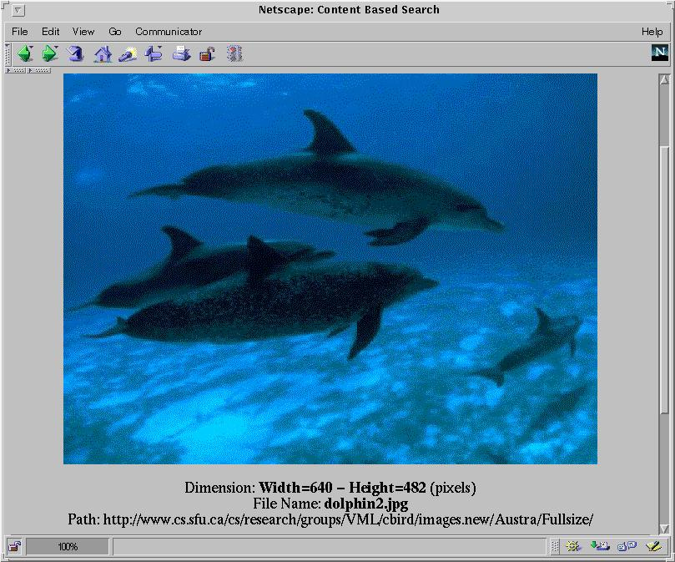
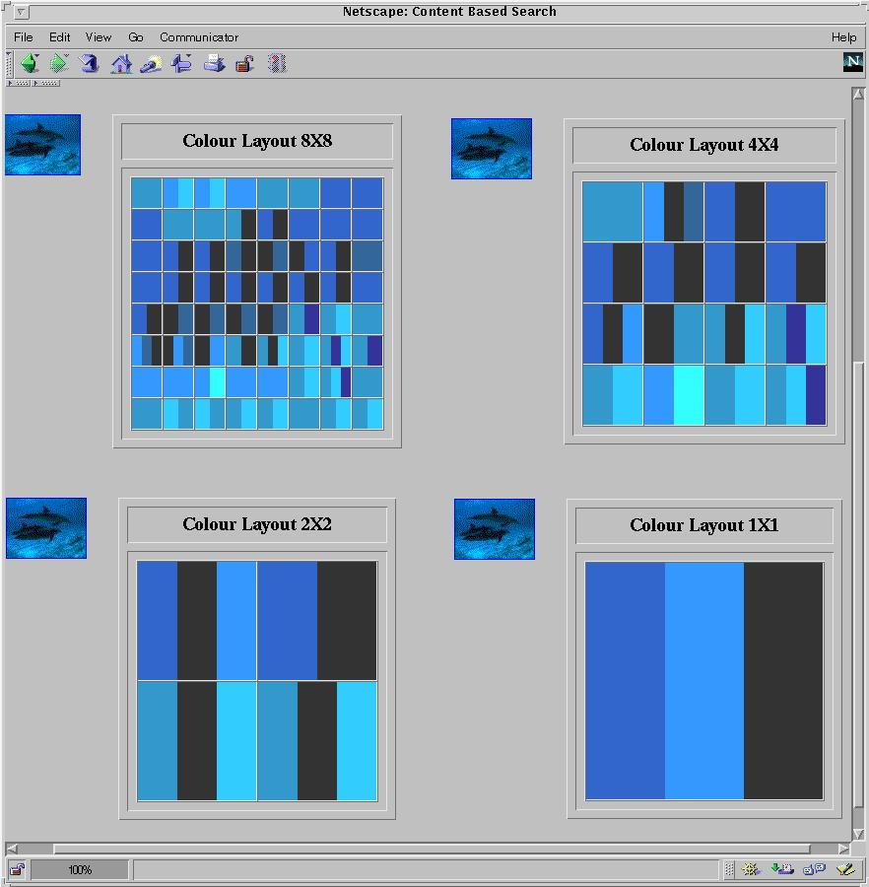
Multi-Dimensional Search in Multimedia Databases

Slide 9
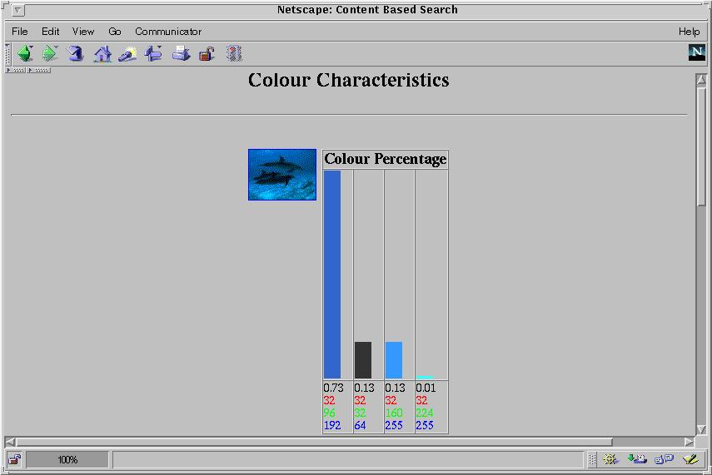
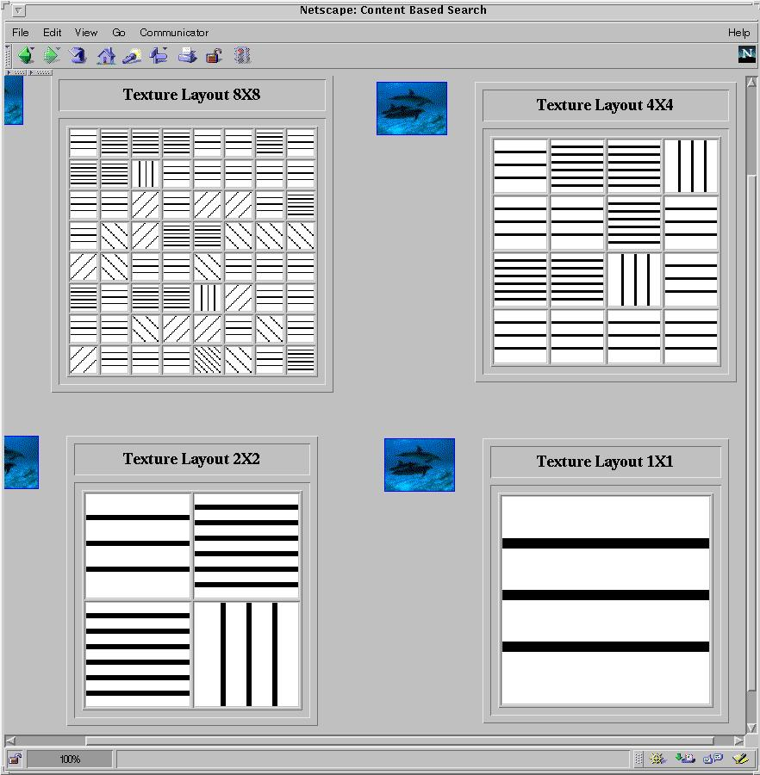
Multi-Dimensional Analysis in Multimedia Databases
Color histogram
Texture layout

Slide 10

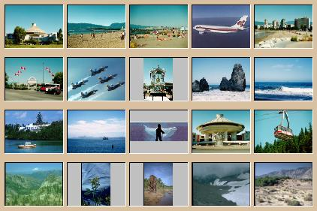

Mining Multimedia Databases
Refining or combining searches
Search for “airplane in blue sky”
(top layout grid is blue and
keyword = “airplane”)
Search for “blue sky and
green meadows”
(top layout grid is blue
and bottom is green)
Search for “blue sky”
(top layout grid is blue)

Slide 11

Mining Multimedia Databases
Three Dimensions
The Data Cube and
the Sub-Space Measurements
JPEG
GIF
Small
Medium
Large
Very Large
Two Dimensions
By Size
By Format
By Format & Size
RED
WHITE
Cross Tab
BLUE
By Colour
By Colour & Size
By Format & Colour
JPEG
GIF
RED
Sum
By Colour
WHITE
BLUE
Format of image
Duration
Colors
Textures
Keywords
Size
Width
Height
Internet domain of image
Internet domain of parent pages
Image popularity
Group By
By Format
Colour
Sum
RED
WHITE
BLUE
Dimensions
Measurement
Sum

Slide 12
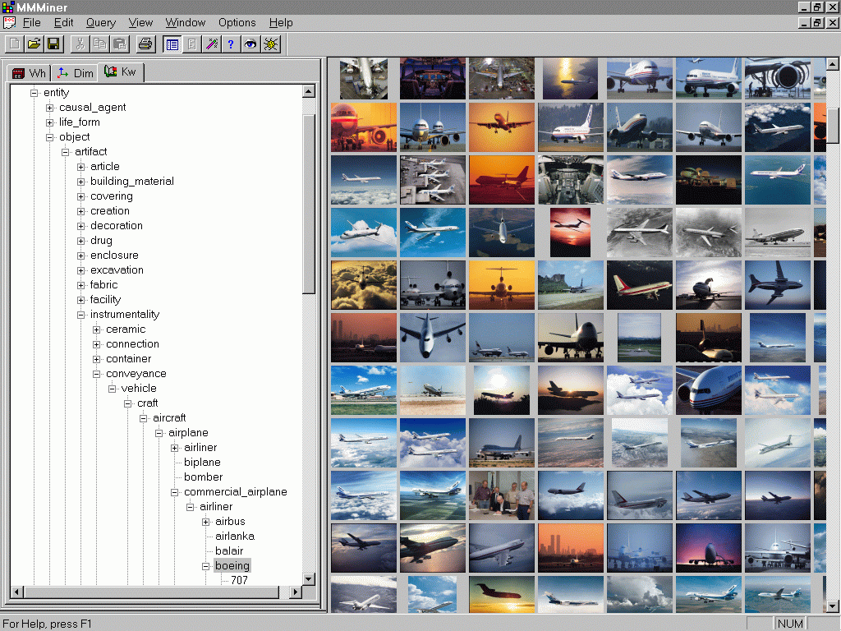
Mining Multimedia Databases in
MultiMediaMiner

Slide 13
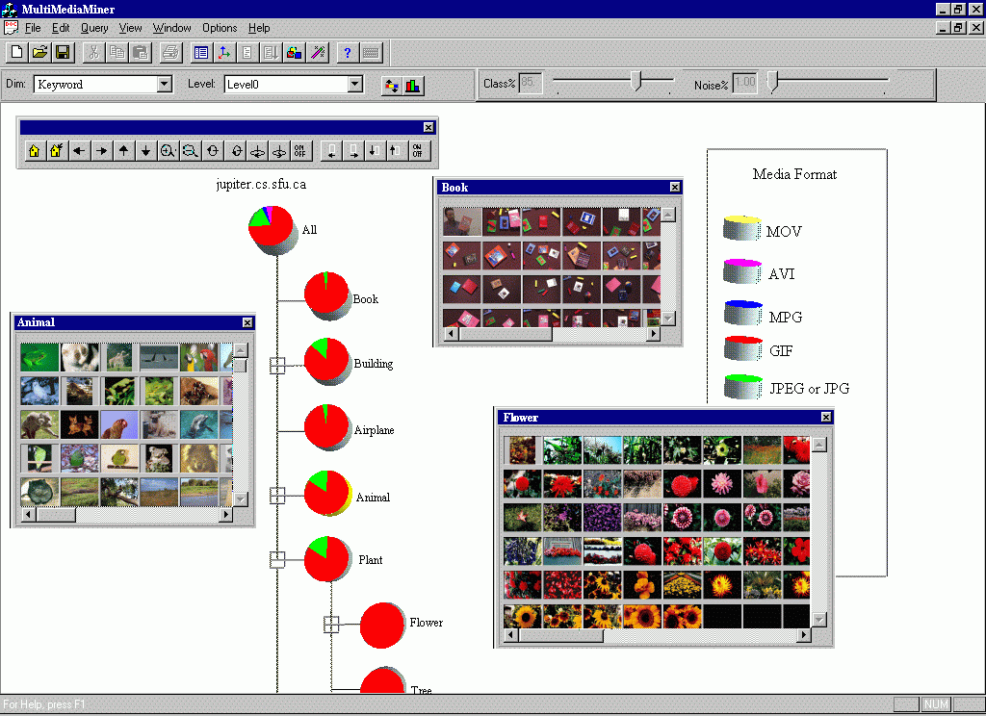
Classification in MultiMediaMiner

Slide 14
Mining Associations in Multimedia Data
Associations between image content and non-image content features
  “If at least 50% of the upper part of the picture is blue, then it is likely to represent sky.”
Associations among image contents that are not related to spatial relationships
  “If a picture contains two blue squares, then it is likely to contain one red circle as well.”
Associations among image contents related to spatial relationships
  “If a red triangle is between two yellow squares, then it is likely a big oval-shaped object is underneath.”

Slide 15
Mining Associations in Multimedia Data
Special features:
  Need occurrences besides Boolean existence, e.g.,
    “Two red square and one blue circle” implies theme “air-show”
  Need spatial relationships
    Blue on top of white squared object is associated with brown bottom
  Need multi-resolution and progressive refinement mining
    It is expensive to explore detailed associations among objects at high resolution
    It is crucial to ensure the completeness of search at multi-resolution space

Slide 16
Mining Multimedia Databases
Spatial Relationships from Layout
property P1 on-top-of property P2
property P1 next-to property P2
Different Resolution Hierarchy

Slide 17
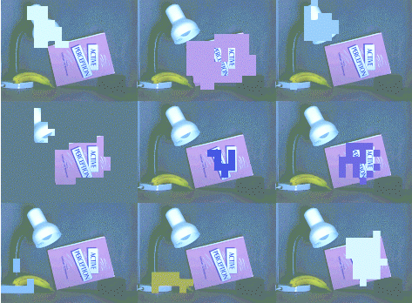

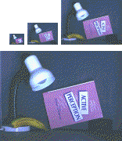
Mining Multimedia Databases
From Coarse to Fine Resolution Mining

